Slide 1

Heart Disease Prediction
Kirat Saran
Pranali Shenvi

Slide 2



Problem Statement
According to CDC, heart disease is one of the leading causes of death for people of most races in the US.
Leading cause
Other factors
Other key factors which lead to heart diseases: diabetic status, obesity (high BMI), not getting enough physical activity or drinking too much alcohol.
High risk factors
About half of all the people in the US have at least 1 of 3 key risk factors for heart disease: high blood pressure, high cholesterol, and smoking.

Slide 3
Motivation
Detecting and preventing the factors that have the greatest impact
Understanding the the major causes of a heart attack
Bringing this understanding to people’s attention

Slide 4
Dataset Source & Attributes
Sr. No. | Column Name | Description
1 | HeartDisease | Person has heart disease or not
2 | BMI | Body Mass Index of the person
3 | Smoking | Person smokes or not
4 | AlcoholDrinking | Person consumes alcohol or not
5 | Stroke | Person had a stroke or not
6 | PhysicalHealth | Number of days Physical health not good
7 | MentalHealth | Number of days Mental health not good
8 | DiffWalking | Person has difficulty in walking or not
9 | Sex | Sex of the person
10 | AgeCategory | Age of the person
11 | Race | Race of the person
12 | Diabetic | Person is diabetic or not
13 | PhysicalActivity | Person performs physical activity or not
14 | GenHealth | General health of the person
15 | SleepTime | Usual sleep time of person in hours
16 | Asthma | Person has asthma or not
17 | KidneyDisease | Person has kidney disease or not
18 | SkinCancer | Person has skin cancer or not
Kaggle: (https://www.kaggle.com) but it is originally from the CDC.
Link: (https://www.kaggle.com/datasets/kamilpytlak/personal-key-indicators- of-heart-disease)
Data ranges from 2020 to February 15th, 2022.
The dataset consists of 319,795 rows and 18 columns.

Slide 5
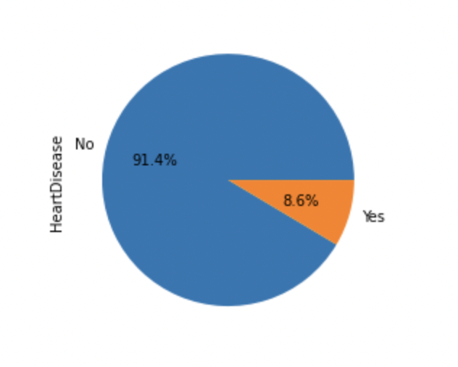
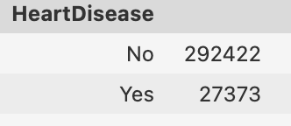
Goal
Use initial methods like std deviation, mean, median to summarize the data set
Predict if the person will have heart disease or not based on key indicators
Almost 8.6% individuals in the dataset have heart disease

Slide 6






Proposed Approach
01
Logistic Regression
We will employ the following classifier models, compare them using performance metrics, and select the most accurate solution.
02
K-Nearest Neighbors
03
Decision Tree
Most notable classifier models
04
XGBoost Classifier
05
Naïve Bayes
06
Random Forest Classifier

Slide 7

Data Cleansing
Checked for Null values
Described the dataset and the datatypes of the variables
Checked for duplicate values
Grouped Numeric and Categorical data

Slide 8
The duplicate dilemma
There are 18078 duplicate values
Normally, we clean/remove duplicate values, but we cannot do that here
There can be numerous people with similar health habits
Not advisable to delete such duplicate values

Slide 9

Exploratory data analysis

Slide 10
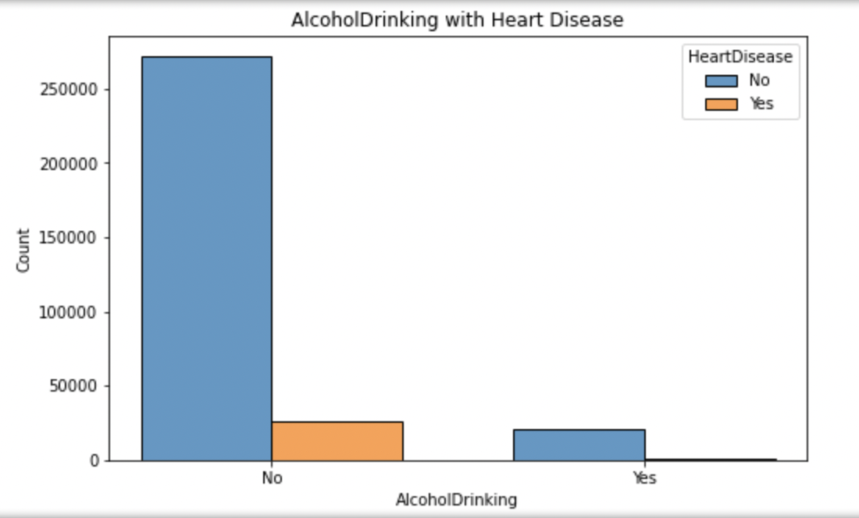
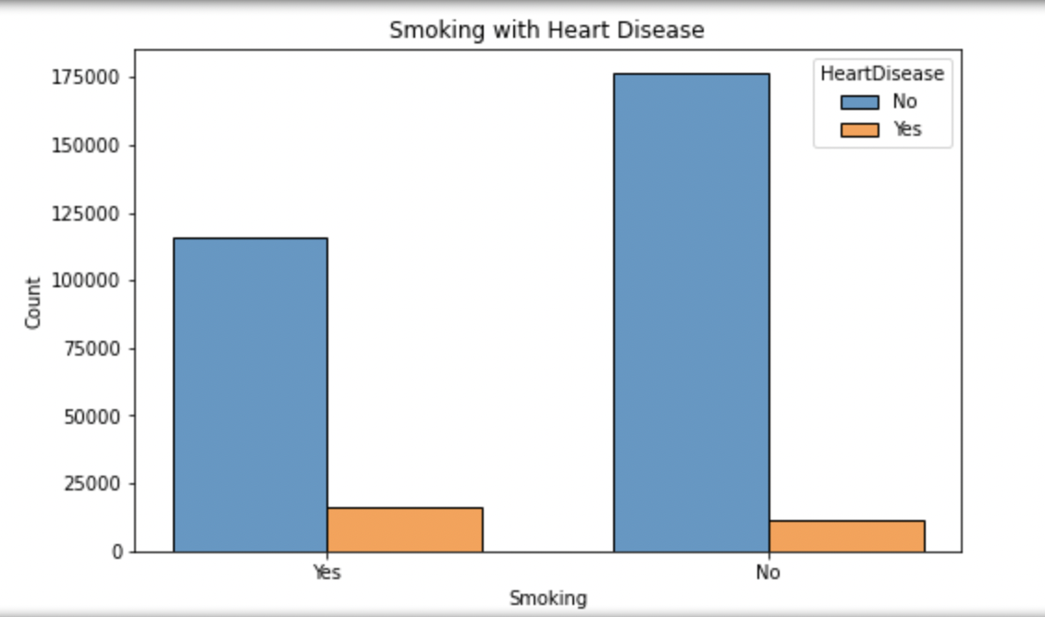
Categorical Variables
Smoking
Alcohol drinking

Slide 11
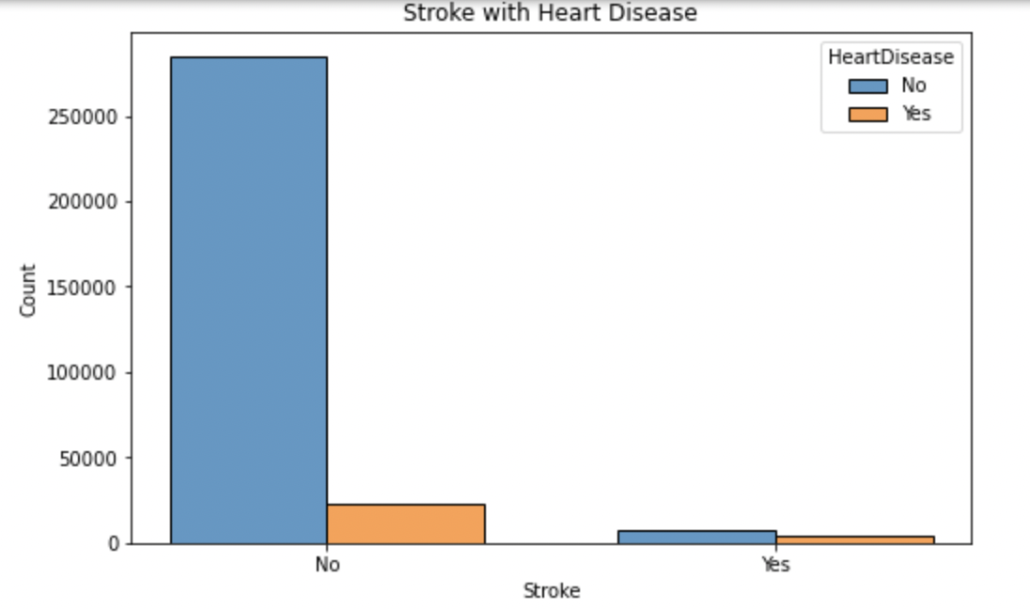
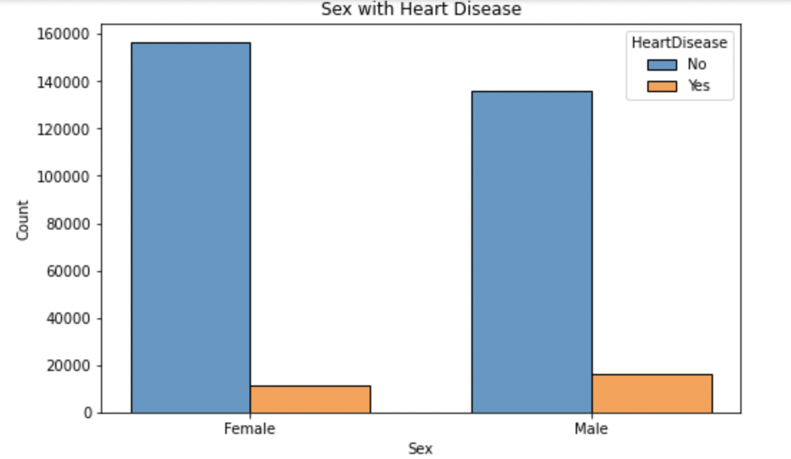
Categorical Variables
Stroke
Sex

Slide 12
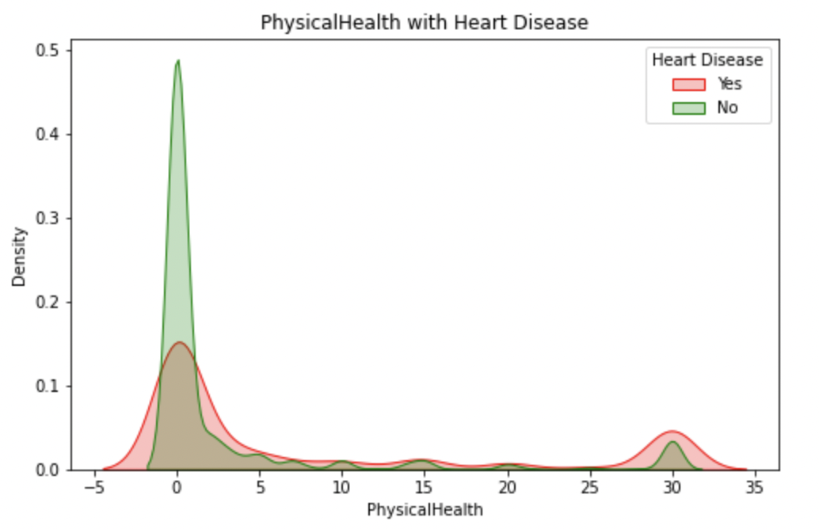
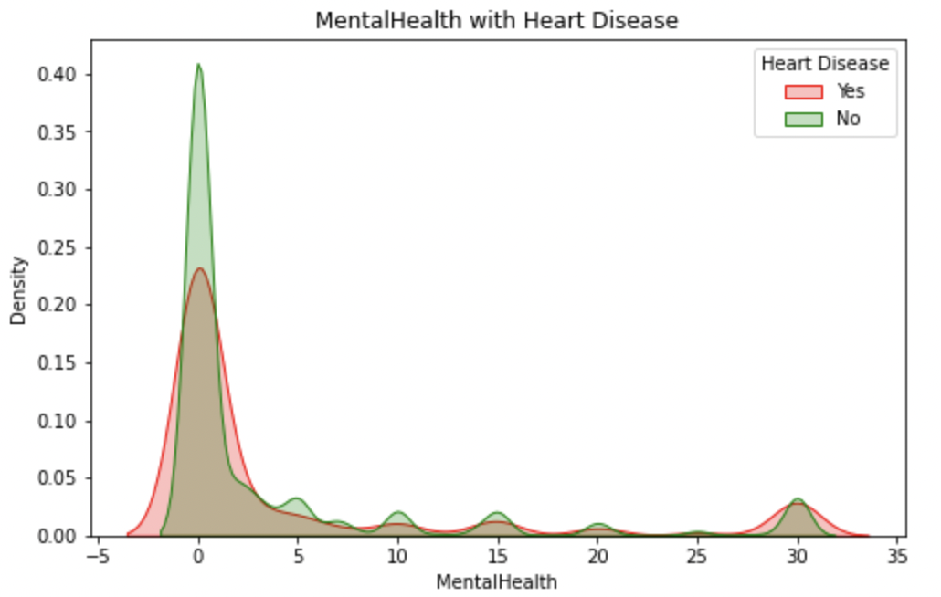
Numerical Variables
Mental Health
Physical Health

Slide 13
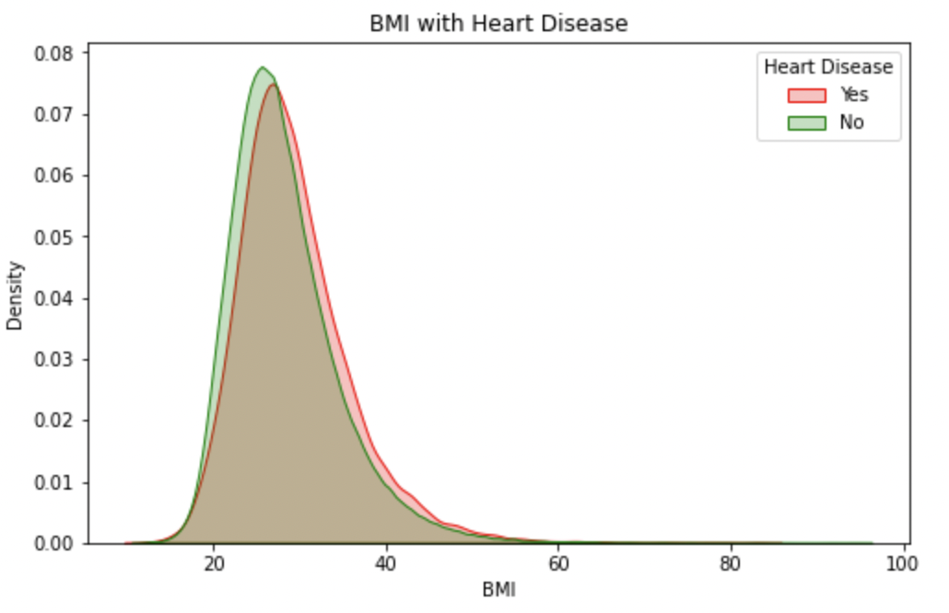
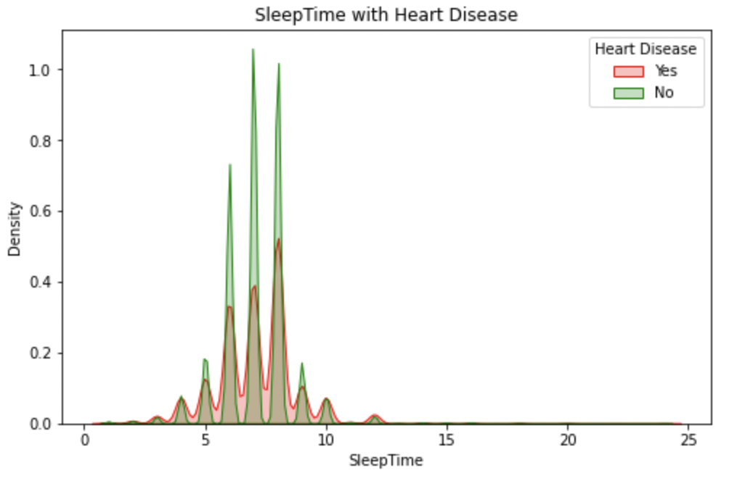
Numerical Variables
Sleep Time
BMI

Slide 14
Pivot Table of Race by Heart Disease
 |  | Heart Disease |  | Percentage
 |  | No | Yes
Race | American Indian/Alaskan Native | 4660 | 542 | 10.42%
 | Asian | 7802 | 266 | 3.30%
 | Black | 21210 | 1729 | 7.54%
 | Hispanic | 26003 | 1443 | 5.26%
 | Other | 10042 | 886 | 8.11%
 | White | 222705 | 22507 | 9.18%

Slide 15
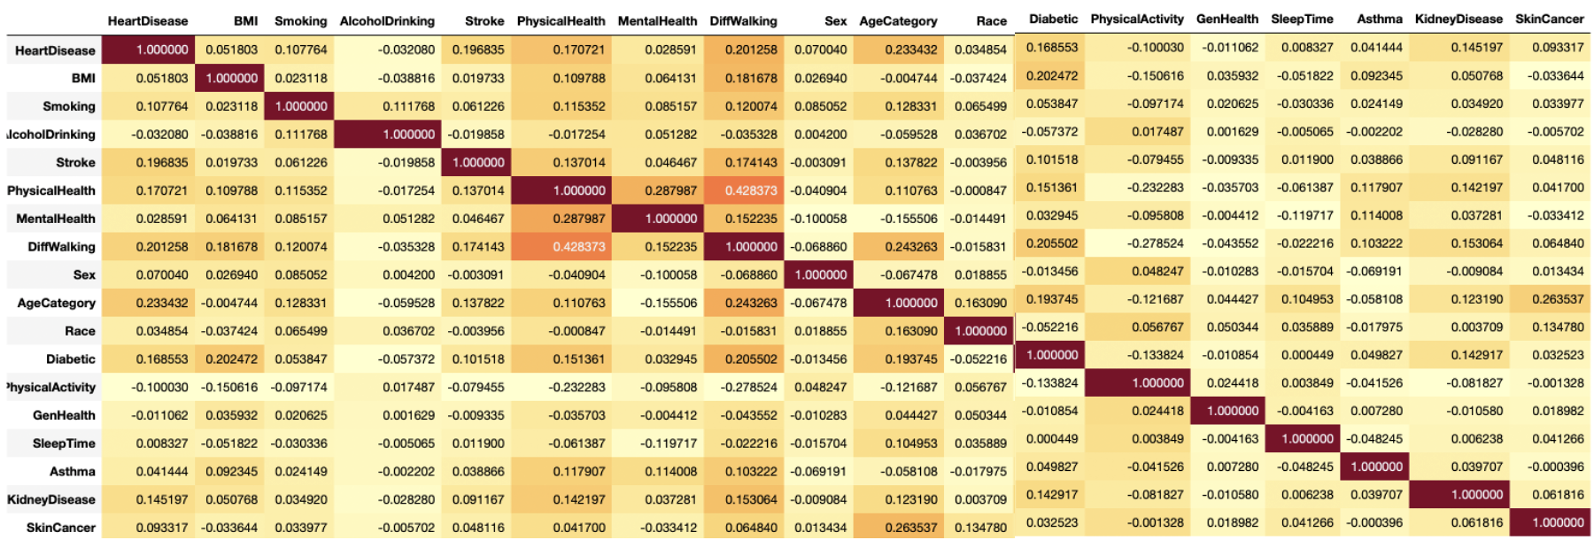
Correlation Heat Map

Slide 16
Data Transformation using Label Encoder
Sr. No. | HeartDisease | BMI | Smoking | AlcoholDrinking | Stroke | PhysicalHealth | MentalHealth | DiffWalking | Sex | AgeCategory | Race | Diabetic | PhysicalActivity | GenHealth | SleepTime | Asthma | KidneyDisease | SkinCancer
0 | 0 | 16.6 | 1 | 0 | 0 | 3 | 30 | 0 | 0 | 7 | 5 | 2 | 1 | 4 | 5 | 1 | 0 | 1
1 | 0 | 20.34 | 0 | 0 | 1 | 0 | 0 | 0 | 0 | 12 | 5 | 0 | 1 | 4 | 7 | 0 | 0 | 0
2 | 0 | 26.58 | 1 | 0 | 0 | 20 | 30 | 0 | 1 | 9 | 5 | 2 | 1 | 1 | 8 | 1 | 0 | 0
3 | 0 | 24.21 | 0 | 0 | 0 | 0 | 0 | 0 | 0 | 11 | 5 | 0 | 0 | 2 | 6 | 0 | 0 | 1
4 | 0 | 23.71 | 0 | 0 | 0 | 28 | 0 | 1 | 0 | 4 | 5 | 0 | 1 | 4 | 8 | 0 | 0 | 0

Slide 17

How to deal with Bias?
Need for sampling
Bias effects
As the ratio of Non-Heart Disease to Heart Disease cases is approximately 9:1, we can say that there is a significant bias
This bias harms our model’s performance
Sampling techniques
Undersampling
We can use 2 sampling techniques to reduce this bias
We select a small sample from the larger class of data to bring down the ratio
Oversampling
SMOTE Oversampling
We extrapolate the smaller class of data to bring down the ratio
SMOTE works by selecting examples that are close in the feature space, drawing a line between the examples in the feature space and drawing a new sample at a point along that line.

Slide 18
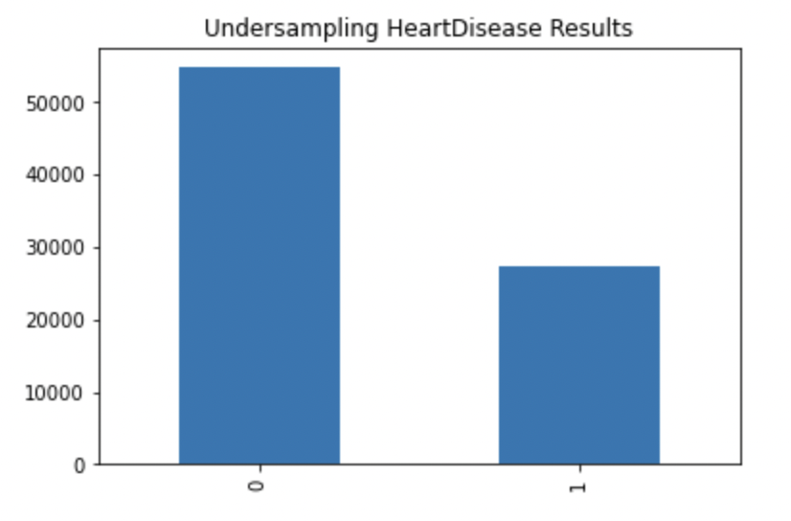
Undersampling

Slide 19
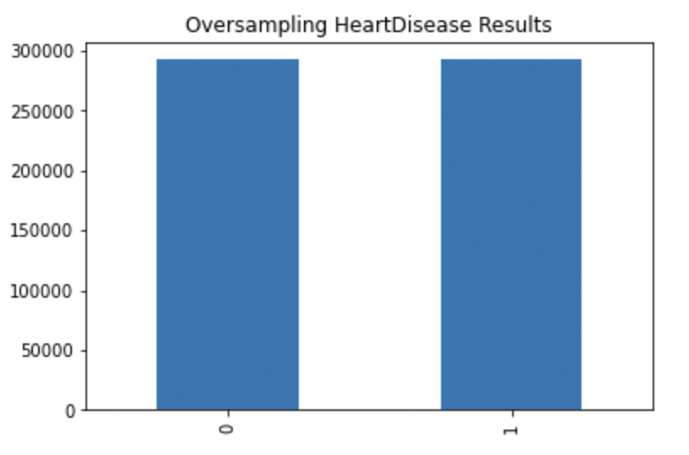
Oversampling

Slide 20
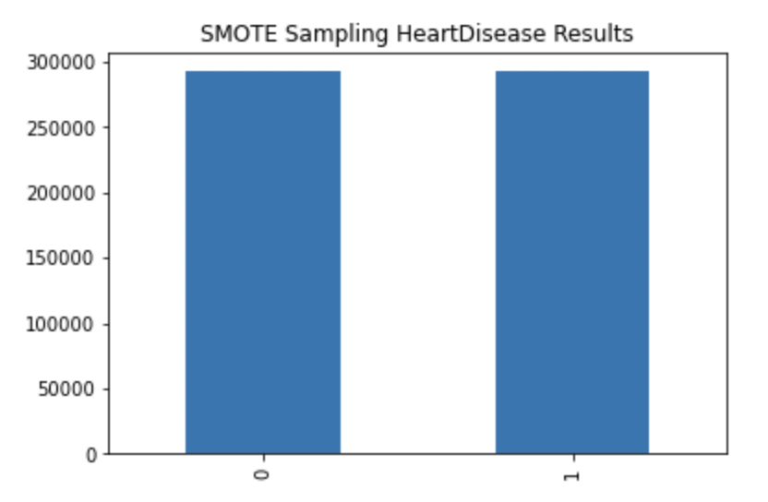
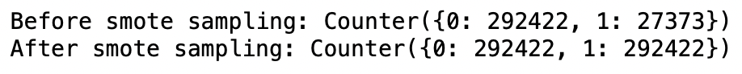
SMOTE Oversampling

Slide 21

Model Evaluation

Slide 22
Logistic Regression
Sampling
Accuracy
Precision
Recall
Unsampled
0.91
0.50
0.09
Undersampled
0.84
0.29
0.54
Oversampled
0.74
0.21
0.76
Oversampled (SMOTE)
0.70
0.18
0.71

Slide 23
K-Nearest Neighbors
Sampling
Accuracy
Precision
Recall
Unsampled
0.90
0.33
0.88
Undersampled
0.82
0.28
0.66
Oversampled
0.88
0.42
0.99
Oversampled (SMOTE)
0.83
0.33
0.97

Slide 24
Decision Trees
Sampling
Accuracy
Precision
Recall
Unsampled
0.86
0.22
0.25
Undersampled
0.82
0.33
0.99
Oversampled
0.99
0.93
0.99
Oversampled (SMOTE)
0.99
0.98
0.96

Slide 25
XGBoost Classifier
Sampling
Accuracy
Precision
Recall
Unsampled
0.91
0.52
0.09
Undersampled
0.84
0.30
0.66
Oversampled
0.75
0.23
0.83
Oversampled (SMOTE)
0.84
0.26
0.46

Slide 26
Naïve Bayes
Sampling
Accuracy
Precision
Recall
Unsampled
0.84
0.27
0.46
Undersampled
0.81
0.24
0.54
Oversampled
0.79
0.23
0.59
Oversampled (SMOTE)
0.71
0.19
0.71

Slide 27
Random Forest
Sampling
Accuracy
Precision
Recall
Unsampled
0.90
0.36
0.11
Undersampled
0.87
0.40
0.99
Oversampled
0.99
0.93
0.99
Oversampled (SMOTE)
0.99
0.96
0.98

Slide 28
Model comparison based on Accuracy
Logistic Regression | 0.91 | 0.84 | 0.74 | 0.70
K Nearest Neighbors | 0.90 | 0.82 | 0.88 | 0.83
Decision Trees | 0.86 | 0.82 | 0.99 | 0.99
XGBoost Classifier | 0.91 | 0.84 | 0.75 | 0.84
Naïve Bayes | 0.84 | 0.81 | 0.79 | 0.71
Random Forest | 0.90 | 0.87 | 0.99 | 0.99
Models
Unsampled
Undersampled
Oversampled
Oversampled (SMOTE)

Slide 29
Model comparison based on Recall
Logistic Regression | 0.09 | 0.54 | 0.76 | 0.71
K Nearest Neighbors | 0.88 | 0.66 | 0.99 | 0.97
Decision Trees | 0.25 | 0.99 | 0.99 | 0.96
XGBoost Classifier | 0.09 | 0.66 | 0.83 | 0.46
Naïve Bayes | 0.46 | 0.54 | 0.59 | 0.71
Random Forest | 0.11 | 0.99 | 0.99 | 0.98
Models
Unsampled
Undersampled
Oversampled
Oversampled (SMOTE)

Slide 30







Significant features to predict Heart disease
Age Category
Physical Health
As the age of a person increases, the probability of getting the heart disease also increases
People with better physical health are less prone to heart disease
Kidney Disease
Diabetes
People having a kidney disease are more prone to getting a heart disease
People having diabetes are more prone to getting a heart disease
Diff Walking
Stroke
The more number of days a person has difficulty walking, the more are the chances of a heart disease
People who have had a stroke are more prone to getting a heart disease

Slide 31
Conclusion
We are deciding best model based on Recall. We cannot rely on accuracy due to bias caused by the imbalanced dataset.
Tree Based models have performed best for our given problem.
Best models – Random Forest and Decision Tree Model

Slide 32
Thank you!

